Slide 1

DEVSECOPS LAB BOOK · PHASE 6: CONTAINER ORCHESTRATION
Chapter 24
Helm
Kubernetes Package Management
Package, template, and deploy applications to Kubernetes.
Manage complex applications with values, templates, and dependencies.
TIME ESTIMATE: 3–4 HOURS

Slide 2

24.0 · CHAPTER GOAL
What You'll Walk Away With
Helm chart structure understood
Instructor Framing
Position Helm as the package manager for Kubernetes — the same mental model as apt or npm, but for whole application stacks. Every chart is a reusable, versioned deployment unit that replaces hand-written, duplicated YAML.
Package applications into charts
Deploy with values customization
MENTAL MODEL
Chart
The package — templates + metadata + defaults
Manage releases (install, upgrade, rollback)
Release
A deployed instance of a chart, tracked by Helm
Use public charts (stable applications)
DevSecOps Lab Book · Chapter 24 · Helm Package Management
2

Slide 3

24.1 · WHY HELM?
From Repetitive YAML to Reusable Templates
Without Helm
With Helm
Deployment, Service, and ConfigMap are all hand-written per environment — prod, staging, dev each need their own near-duplicate YAML files with only small value changes (replica count, image tag, hostnames).
One chart with templated YAML reads values from a single values.yaml. Swap environments by swapping the values file — the templates never change.
# values.yaml
metadata:
environment: production
name: myapp-prod
replicas: 3
labels: {app: myapp, env: production}
database_host: postgres-prod...
spec:
replicas: 3
# templates/deployment.yaml
---
{{ .Values.environment }}
kind: Service
{{ .Values.replicas }}
name: myapp-prod-service
{{ .Values.database_host }}
---
kind: ConfigMap # repeated per env...
→ One chart, infinite configurations
DevSecOps Lab Book · Chapter 24 · Helm Package Management
3

Slide 4
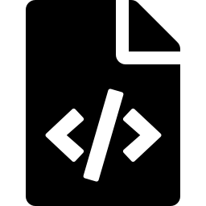
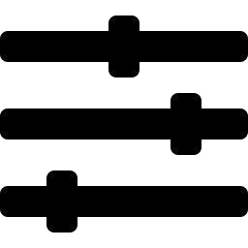

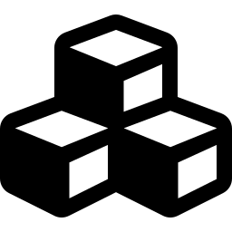
24.2 · HELM CHART STRUCTURE
Anatomy of a Chart Directory
myapp-chart/
Chart.yaml
Metadata: name, version, appVersion, maintainers
├─ Chart.yaml
Chart metadata
├─ values.yaml
Default values
values.yaml
├─ templates/
Kubernetes resources
Default configuration values consumed by templates
├─ deployment.yaml
├─ service.yaml
templates/
├─ configmap.yaml
Go-templated Kubernetes manifests rendered at install time
├─ secret.yaml
├─ _helpers.tpl
Template helpers
charts/
├─ charts/
Subchart dependencies
Vendored or downloaded subchart dependencies
├─ README.md
Documentation
DevSecOps Lab Book · Chapter 24 · Helm Package Management
4

Slide 5
24.2 · METADATA & DEFAULTS
Chart.yaml vs. values.yaml
Chart.yaml
values.yaml
apiVersion: v2
replicaCount: 3
name: myapp
image:
description: A Helm chart for MyApp
repository: harbor.../myapp
type: application
tag: "1.0.0"
version: 1.0.0
service:
appVersion: "2.1.0"
type: LoadBalancer
keywords: [myapp, application]
port: 80
home: https://myapp.dev
resources:
limits: {cpu: 500m, memory: 512Mi}
maintainers:
autoscaling:
- name: John Doe
enabled: true
Identifies the chart: name, version, appVersion, ownership.
The knobs: every value a template can reference & override.
DevSecOps Lab Book · Chapter 24 · Helm Package Management
5

Slide 6
24.3 · TEMPLATING
Go Templates Render Kubernetes YAML
templates/deployment.yaml
_helpers.tpl
apiVersion: apps/v1
{{- define "myapp.fullname" -}}
kind: Deployment
{{ .Release.Name }}-{{ .Chart.Name }}
metadata:
{{- end }}
name: {{ include "myapp.fullname" . }}
spec:
Reusable naming & label snippets, included across templates.
{{- if not .Values.autoscaling.enabled }}
replicas: {{ .Values.replicaCount }}
{{- end }}
READ THE SYNTAX
template:
spec:
{{ .Values.x }} — pull from values.yaml
containers:
{{ .Release.Name }} — release-scoped name
- name: {{ .Chart.Name }}
{{- if }} / {{- end }} — conditionals
image: "{{ .Values.image.repository }}:{{ .Values.image.tag }}"
resources:
nindent 12 — reindent nested YAML
{{- toYaml .Values.resources | nindent 12 }}
DevSecOps Lab Book · Chapter 24 · Helm Package Management
6

Slide 7




24.4 · MANAGING RELEASES
Install · Upgrade · Rollback · Uninstall
Install
Upgrade
helm install myapp ./chart --set replicaCount=5
helm upgrade --atomic myapp ./chart --set image.tag=2.1.0
Rollback
Uninstall
helm rollback myapp 2
helm uninstall myapp -n myapp-production
DevSecOps Lab Book · Chapter 24 · Helm Package Management
7

Slide 8

24.5 · PUBLIC CHARTS
Artifact Hub: Install Stable Applications
→
→
→
Add Repo
Update
Search
Install
helm repo add jetstack https://charts.jetstack.io
helm repo update
helm search repo prometheus
helm install cert-manager jetstack/cert-manager
COMMON REPOSITORIES
prometheus-community
https://prometheus-community.github.io/helm-charts
Monitoring stack
jetstack
https://charts.jetstack.io
cert-manager (HTTPS/TLS)
bitnami
https://charts.bitnami.com/bitnami
PostgreSQL, Redis, and more
DevSecOps Lab Book · Chapter 24 · Helm Package Management
8

Slide 9

24.6 · CHART DEPENDENCIES
Composing Stacks from Subcharts
Chart.yaml
Composed Stack
name: myapp-stack
myapp-stack (parent)
dependencies:
- name: postgresql
version: "11.x.x"
myapp
repository: https://charts.bitnami.com/bitnami
condition: postgresql.enabled
postgresql
- name: redis
version: "17.x.x"
redis
condition: redis.enabled
- name: myapp
helm dependency update
repository: file://../myapp-chart
downloads charts into charts/
DevSecOps Lab Book · Chapter 24 · Helm Package Management
9

Slide 10
24.7 · VALUES OVERRIDES
One Chart, Many Environments
values-prod.yaml
values-dev.yaml
replicaCount
5
replicaCount
1
image.tag
2.1.0
image.tag
latest
resources.requests.cpu
1000m
resources.requests.cpu
100m
autoscaling.minReplicas
5
autoscaling.enabled
false
autoscaling.maxReplicas
20
autoscaling.maxReplicas
—
postgresql.persistence
100Gi
postgresql.persistence
10Gi
helm install myapp ./chart -f values-prod.yaml -n production | helm install myapp-dev ./chart -f values-dev.yaml -n development
DevSecOps Lab Book · Chapter 24 · Helm Package Management
10

Slide 11
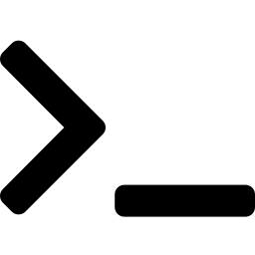

24.8 · DRY RUN & DEBUGGING
Preview Before You Deploy
Preview Changes
Lint the Chart
helm lint ./myapp-chart
helm install myapp ./chart \
--dry-run --debug
helm template myapp ./chart
[INFO]
Chart.yaml: icon is missing
[WARNING]
Chart.yaml: unsupported API version
Renders manifests locally without touching the cluster — the fastest way to catch templating mistakes.
[ERROR]
values.yaml: invalid YAML
Catches structural and syntax errors before install/upgrade.
DevSecOps Lab Book · Chapter 24 · Helm Package Management
11

Slide 12
24.10 · CHAPTER SUMMARY
Feature Reference
Feature | Purpose | Example
Chart.yaml | Metadata | Name, version, description
values.yaml | Default config | Replicas, image, resources
Templates | Kubernetes YAML | Deployment, Service
Helm Install | Deploy application | helm install myapp ./chart
Helm Upgrade | Update version | helm upgrade myapp ./chart
Helm Rollback | Revert to previous | helm rollback myapp
Chart · Release · Repository — the three nouns that make Helm click.
DevSecOps Lab Book · Chapter 24 · Helm Package Management
12

Slide 13
KEY TAKEAWAY
Reusable, Manageable Applications
BEFORE HELM
AFTER HELM
✕ Complex YAML files
✓ Templated, DRY YAML
✕ Repetitive configuration
✓ Configurable with values
✕ Hard to share applications
✓ Share charts on Artifact Hub
✕ Manual version management
✓ One-command deployments
DevSecOps Lab Book · Zero to Hero · Chapter 24 · Phase 6: Container Orchestration

